Slide 1

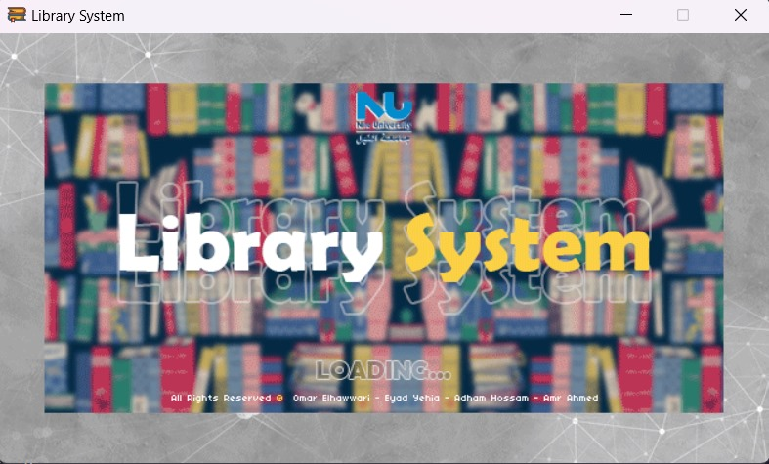
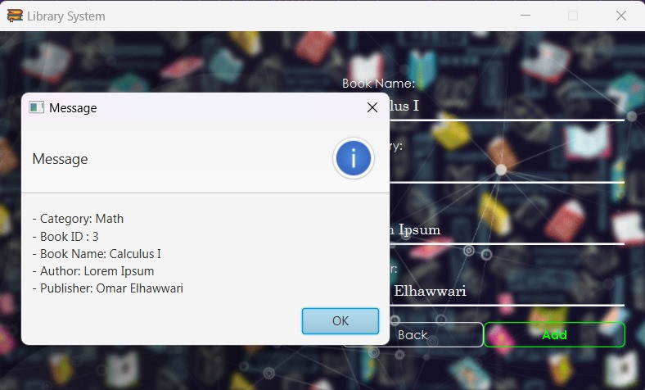

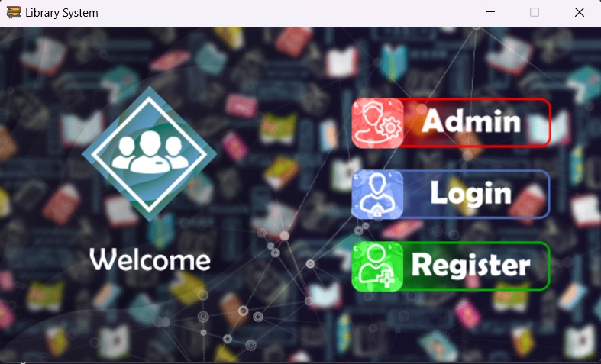
Our library system, crafted with Java and MySQL, excelled in data management, user interface design, and automation integration. Java's versatility and JavaFX's user-friendly interface ensured a seamless experience. Challenges like self-checkout and automation were met with a balanced approach. Agile methodologies enabled iterative testing, refining the system responsively. The phased deployment and thorough training resulted in smooth implementation. Continuous monitoring and support post-implementation reflect our commitment. In conclusion, our project surpassed expectations, providing a robust and adaptable library solution, showcasing the power of Java and MySQL in creating a high-quality, user-centric system.
Message @7y86
CSCI313
Library System
Abstract
The Library System, developed predominantly in Java, offers a secure and versatile library management solution. Featuring distinct Admin and User Modes, the system prioritizes security with password confirmation and OTP verification during registration. Key specifications include a creative graphical user interface, functionalities for administrators (book management, borrowing periods), and users (book browsing, borrowing, account management). The system is designed to meet the needs of institutions and universities, emphasizing maintainability as essential non-functional requirements.
Methodology
The development methodology for our library system primarily revolves around the use of Java as the main programming language and MySQL as the primary database management system. We initiated the process with a comprehensive requirement analysis, engaging stakeholders to understand user needs and define project objectives. Subsequently, we strategically selected Java for its versatility and platform independence, while MySQL was chosen to efficiently store and manage the system's diverse data elements. The system's architecture and database schema were meticulously designed, optimizing data storage and retrieval. Leveraging Java's Swing or JavaFX, we crafted an interactive and user-friendly interface, refining its design through usability testing. The core functionalities were implemented using Java, following object-oriented principles for modular and scalable code..
Discussion and Conclusion
Our library system, crafted with Java and MySQL, excelled in data management, user interface design, and automation integration. Java's versatility and JavaFX's user-friendly interface ensured a seamless experience. Challenges like self-checkout and automation were met with a balanced approach. Agile methodologies enabled iterative testing, refining the system responsively. The phased deployment and thorough training resulted in smooth implementation.
Group Members
Main Results

